Slide 1
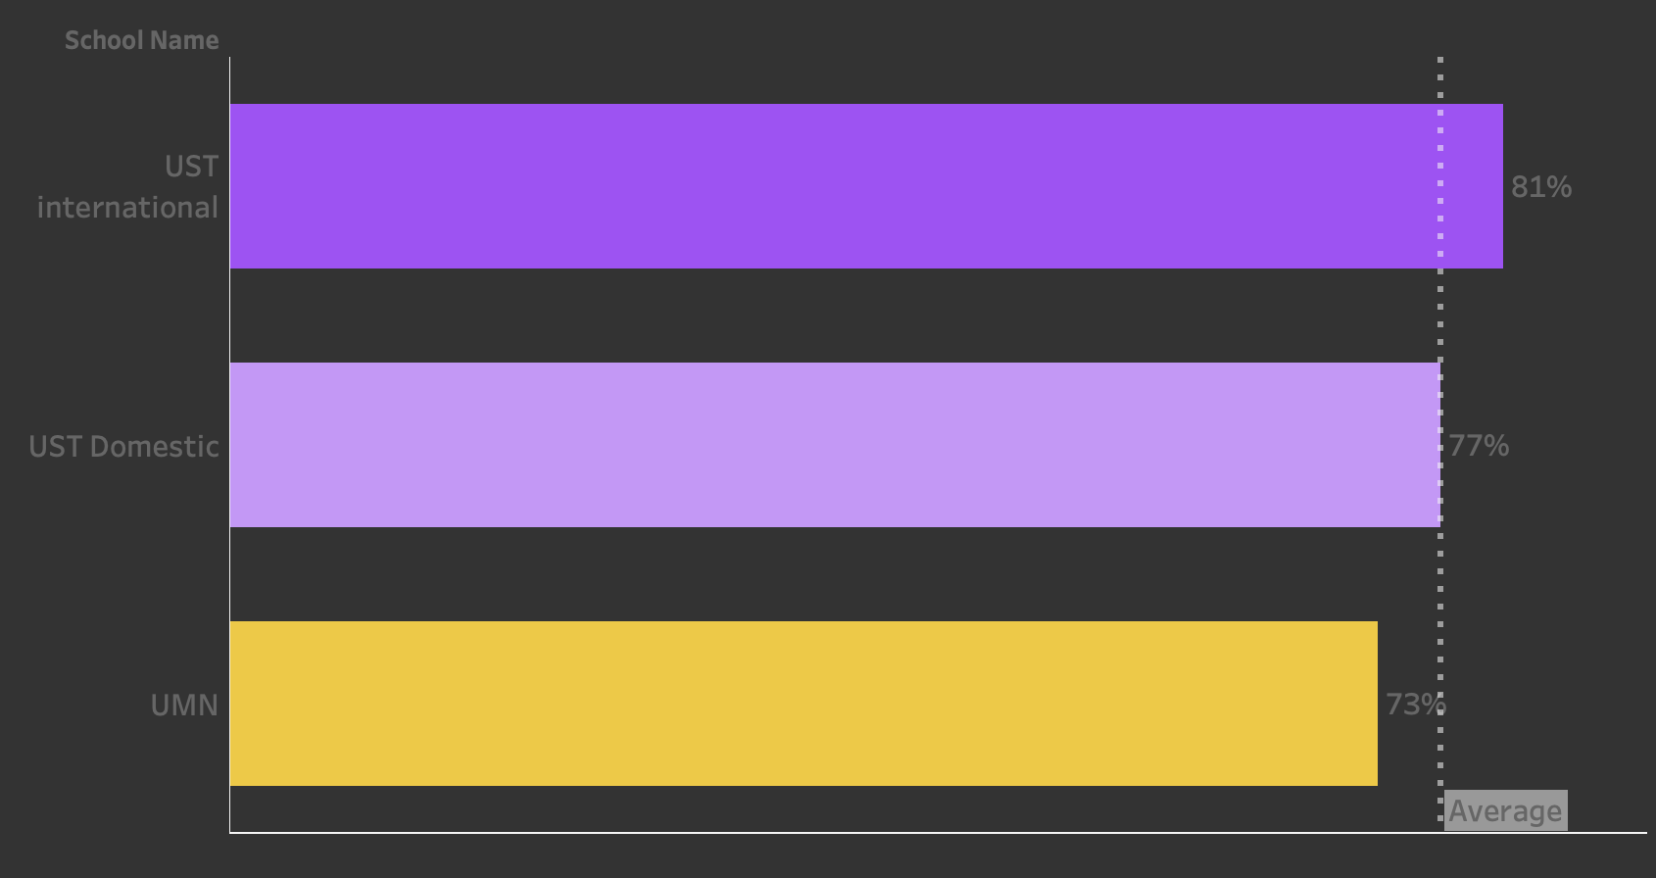
St. Thomas Cares Just Like You Do!
Undergraduate International Admission
Morgan Meng- BUAN 610

Slide 2
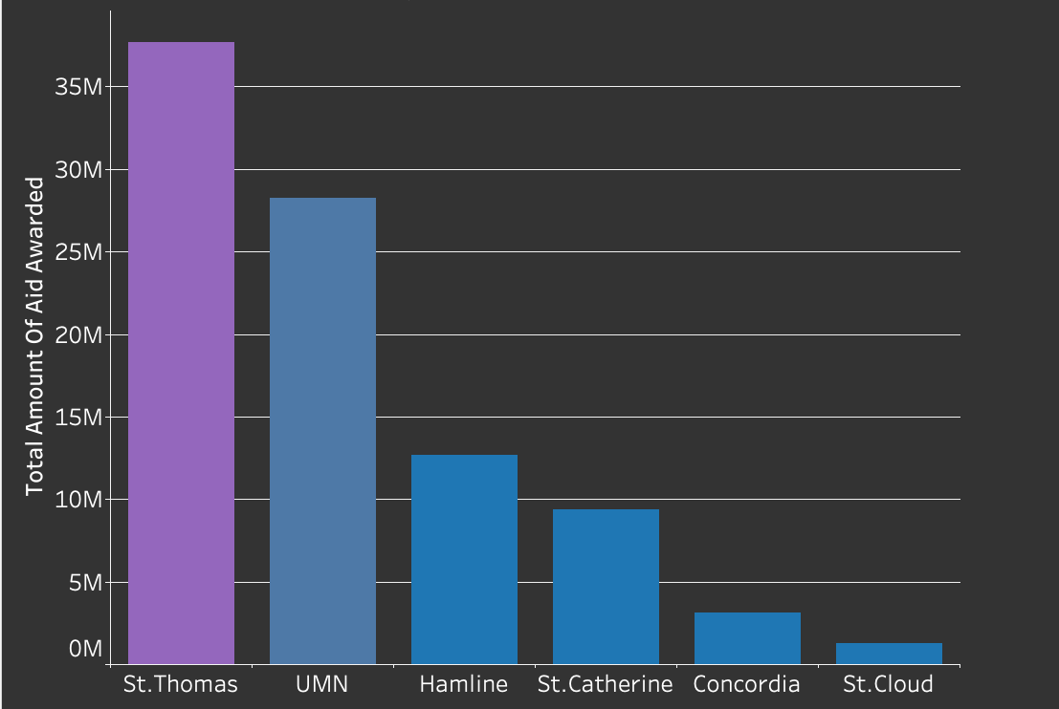
Dominating the Field: St. Thomas Leads in Scholarship Awards Among Peers
Total Amount of Merit-Based Scholarships By Schools Year 2021-2022

Slide 3
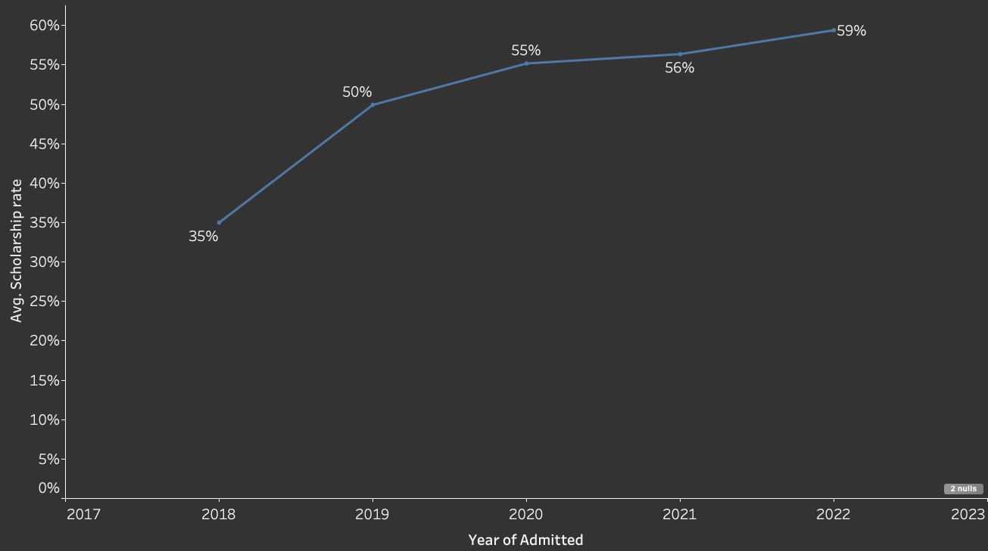
Ascending to New Heights: Average Scholarship Percentages Soar from 35% to 60% Over 6 Years
Trend of Average Merit-based Scholarship Percentages (2018-2023) for Admitted International Students

Slide 4
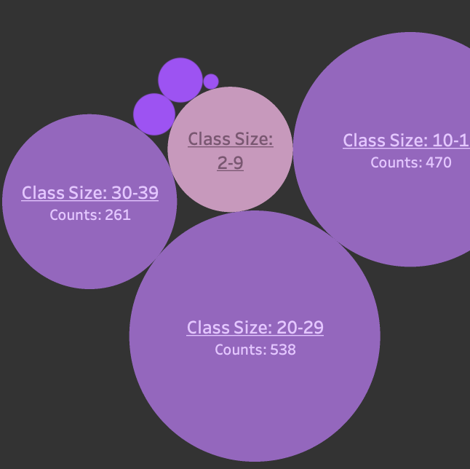
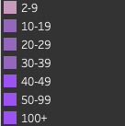
Small Class Advantage: Visualizing the Benefits with Average Class Size of 21
St. Thomas Class Size Counts, 2023-2024

Slide 5
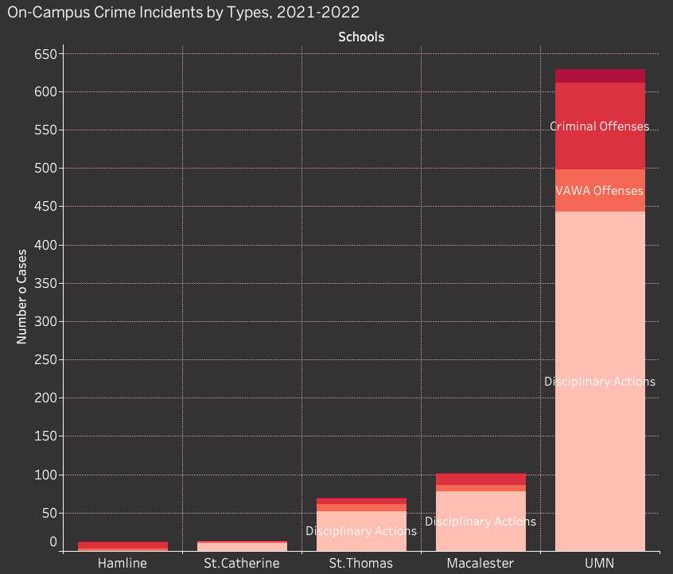
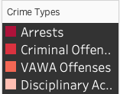
We Care Just Like You Do! St. Thomas Keeps Students Safe!

Slide 6
Minto Principle – Overall Structure-Final Project
High Admission Rate = Good?
High Admission rate indicating welcoming Intl Students.
!However, parents cares more about what their children can be actually taken cared.
Finance:
1. Scholarships =Financial burden relief
2. Advantageous scholarships percentage comparing to competitors
3. Students and family could be more content financially
VISUAL: Bar charts for comparison, line chart for scholarships rate change over times
Academic:
class size & faculty/students ratio
VISUAL: Bubble charts/ pie chart to show the mode and median class size
Safety:
1. Location: safe neighborhood
2. Low on-campus crime rate
VISUAL: Bar Chart for comparison

